Slide 1
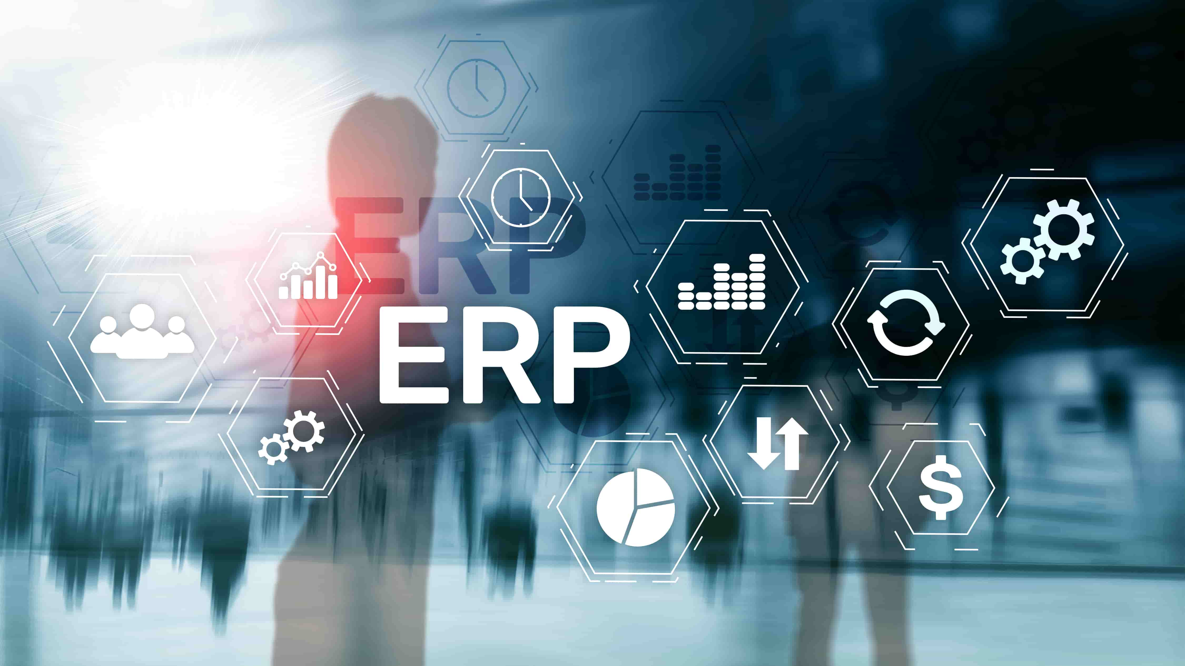

Selçuk Çalışkan-14030411041 Bedia AYDINLI -1403041137 Zeynep ALTUNKAYNAK-15030411030 Hatice Özgenur GÖŞELİ – 15030411014 Barış ÖZER- 15030411021 Muhammed Topgül-15030411040

Slide 2
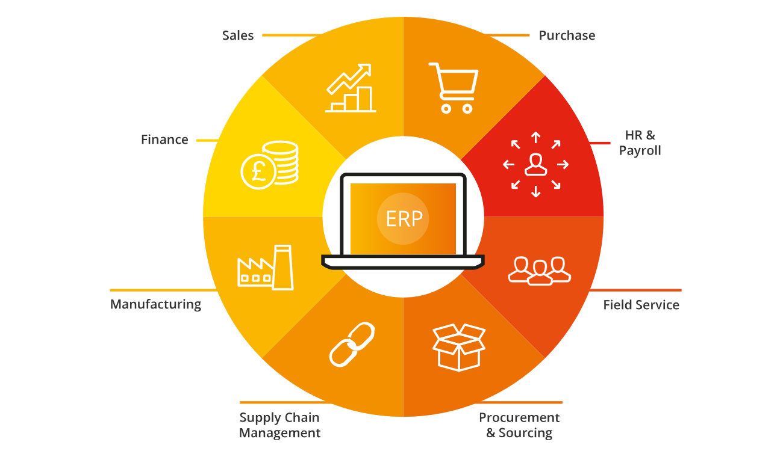
What is the simplest ERP definition?
ERP stands for Enterprise Resource Planning
Think about all the core processes needed to run a company: finance, HR, manufacturing, supply chain, services, procurement, and others. At its most basic level, ERP integrates these processes into a single system.
But new ERP systems are anything but basic. They use the latest technologies – such as machine learning and AI – to provide intelligence, visibility, and efficiency across every aspect of a business.

Slide 3
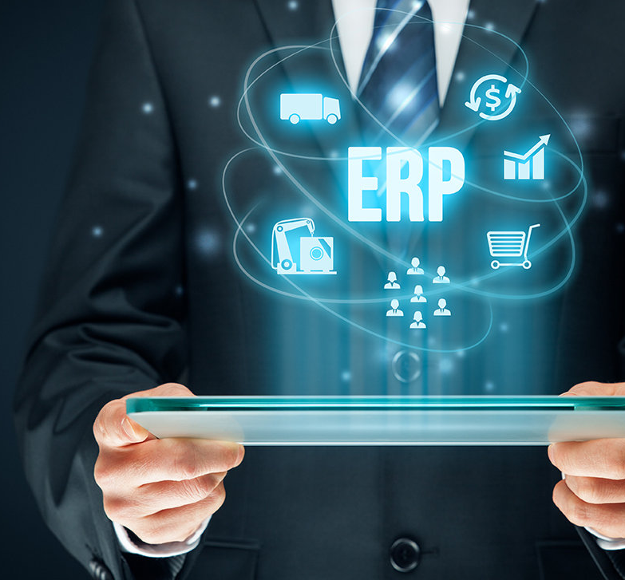
When you search for "ERP" on the web, the sheer amount of information that comes up can be overwhelming—not to mention a little confusing. Every website seems to have its own definition of ERP, and one ERP implementation can vary widely from the next. These differences, however, underscore the flexibility that can make ERP such a powerful business tool. To get a deeper understanding of how ERP solutions can transform your business, it helps to get a better sense of what ERP actually is and how it works. Here's a brief introduction to ERP and why it seems like everyone's talking about it.
ABOUT ERP

Slide 4
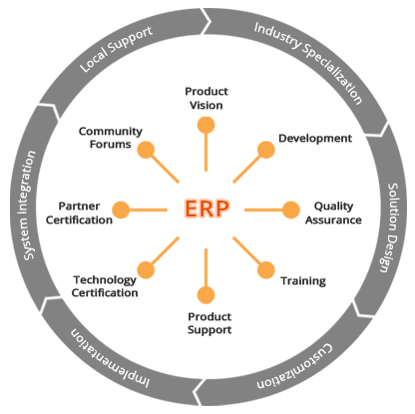
ERP Integrates Processes Across Business Functions
ERP is an acronym for Enterprise Resource Planning, but even its full name doesn't shed much light on what ERP is or what it does. For that, you need to take a step back and think about all of the various processes that are essential to running a business, including inventory and order management, accounting, human resources, customer relationship management (CRM), and beyond. At its most basic level, ERP software integrates these various functions into one complete system to streamline processes and information across the entire organization.
The central feature of all ERP systems is a shared database that supports multiple functions used by different business units. In practice, this means that employees in different divisions—for example, accounting and sales—can rely on the same information for their specific needs.

Slide 5
HISTORY OF ERP
INVENTORY MANAGEMENT AND CONTROL
MANUFACTURING REQUIREMENT P.(MRP2)
ENTERPRISE RESOURCE PLANNING
MATERIAL REQUIREMENT PLANNING(MRP)
CLOUD-BASED ERP
WEB FUNCTIONALITIES WITH INTERNET(ERP2)
1960s
1970s
1980s
1990s
2000s
2010s

Slide 6

Inventory Management & Control (the 1960s)
Inventory Management and control is a combination of information technology and business processes. Business processes of maintaining the appropriate level of stock in a warehouse.
The activities of inventory management include,
Identifying inventory requirements.
Setting targets.
Providing replenishment techniques and options.
Monitoring item usages.
Reconciling the inventory balances.
Reporting inventory status.
Bu Fotoğraf, Bilinmeyen Yazar, CC BY-SA altında lisanslanmıştır

Slide 7

Material Requirement Planning (MRP)(the 1970s)
Materials requirement planning (MRP) utilizes software applications for scheduling production processes. MRP generates schedules for operations and raw material purchases.
Scheduling is based on,
Production requirements for finished goods.
Structure of the production system.
Current inventory levels.
Lot-sizing procedure for each operation.

Slide 8
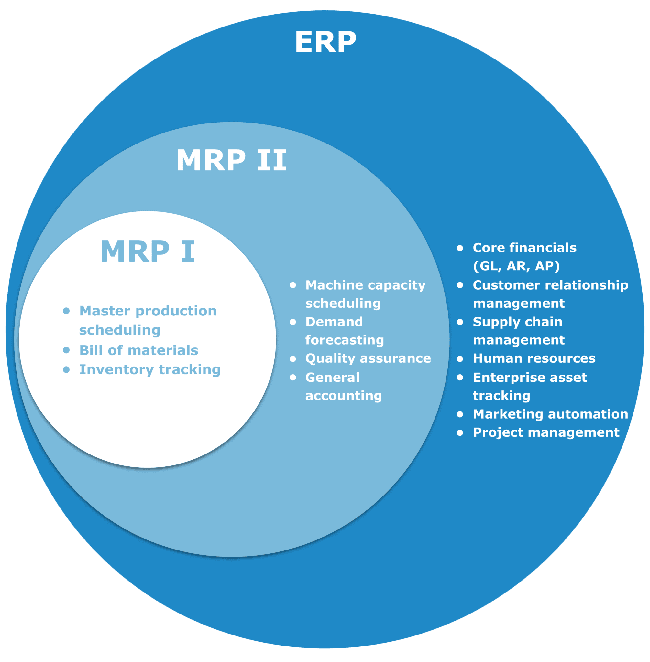
Manufacturing Requirements Planning (MRP II) (the 1980s)
Manufacturing requirements planning or MRP II utilizes software applications. Applications for coordinating manufacturing processes. Processes from product planning, parts purchasing, inventory control to product distribution.
Enterprise Resource Planning (ERP) (the 1990s)
Enterprise resource planning or ERP uses a multi-module application software system. Software for improving the performance of the internal business processes. ERP systems often integrate business activities across functional departments.

Slide 9

Web Functionalities with Internet (ERP II) (the 2000s)
Interaction of ERP with other application suite is enabled in ERP II. An example is integrating with CRM systems.
Technological advancementAccessing information using internet web-browsers and mobile devices were made possible.
Technological advancement with Services Oriented Architecture (SOA) was adapted.
Bu Fotoğraf, Bilinmeyen Yazar, CC BY-NC-ND altında lisanslanmıştır

Slide 10
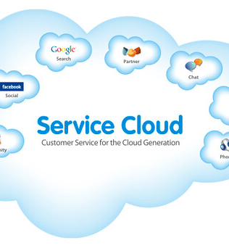
Cloud-based ERP (the 2010s)
Business applications are delivered as software as a service (SaaS) model. Servers are deployed on the cloud and accessed with rest APIs. Android, iOS, and browser applications are developed for delivering ERP software in the SaaS model.

Slide 11

Future of history of ERP
Big data analysis and advanced reporting.
Machine learning.
Artificial intelligence and automation.
Data integrity with blockchain technology.
Virtual reality for better interactions.
The history of ERP was always accompanied by the advancement in technology. It will continue to progress to boost business growth.
Bu Fotoğraf, Bilinmeyen Yazar, CC BY altında lisanslanmıştır

Slide 12

What Types of Companies Use ERP Programs?
Small businesses and mega-corporations alike use ERP software to streamline their workflows. Enterprise resource solutions are also used across various industries. Some of the industries where small and large businesses commonly use ERP software include:
Retail
Manufacturing
Pharmaceutical
Distribution
Technology
Hospitality
Construction
Aerospace and Defense
If you don’t see your industry listed above, that doesn’t mean other companies in your industry aren’t already using ERP solutions. Depending on the ERP vendor, software can be customized or configured based on the specific needs of your industry. For example, many pharmaceutical companies that use ERP are able to keep track of legal regulations through their ERP system, which allows them to then update their workflow accordingly.

Slide 13
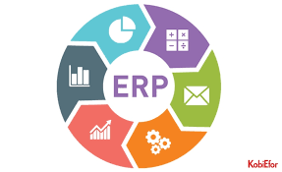

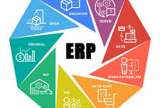
WHY is ERP Necessary?
There is not a single solution that covers all business processes, ERP technology continues to make progress in bringing together all of your business processes, improving collaboration, helping your organization to make data-driven decisions and improving business productivity.

Slide 14
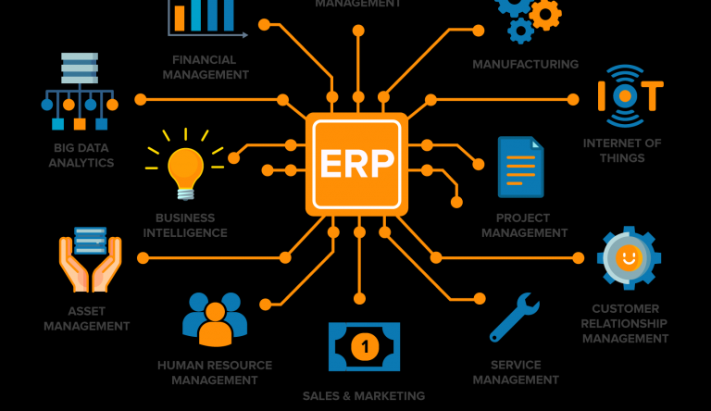

Slide 15
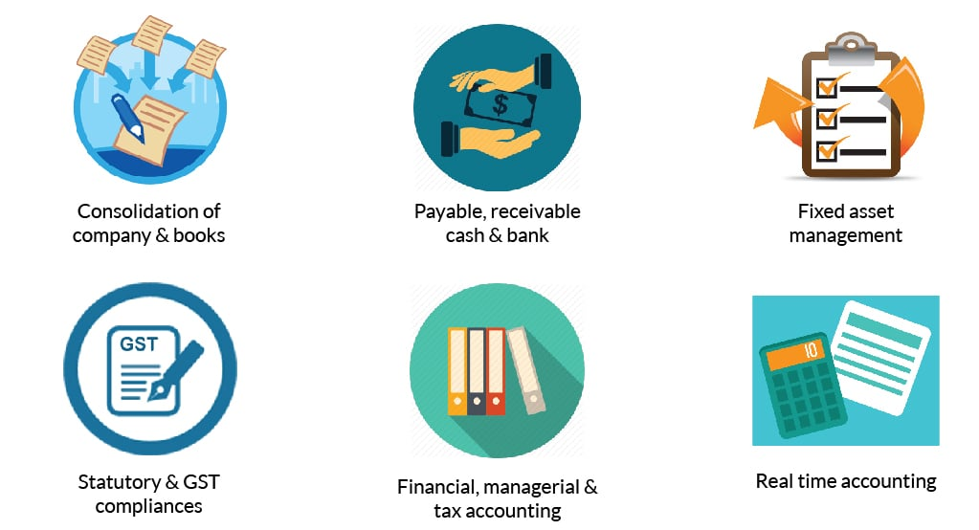
FINANCE
Modern ERP also provides dashboards where you can take an overview of your financial situation and you can take advantage of real-time information whenever and wherever you want.
It should also help you reduce situations that require you to manually enter information by automating everyday tasks and include monitoring features that are useful for your organization's regulatory compliance.

Slide 16
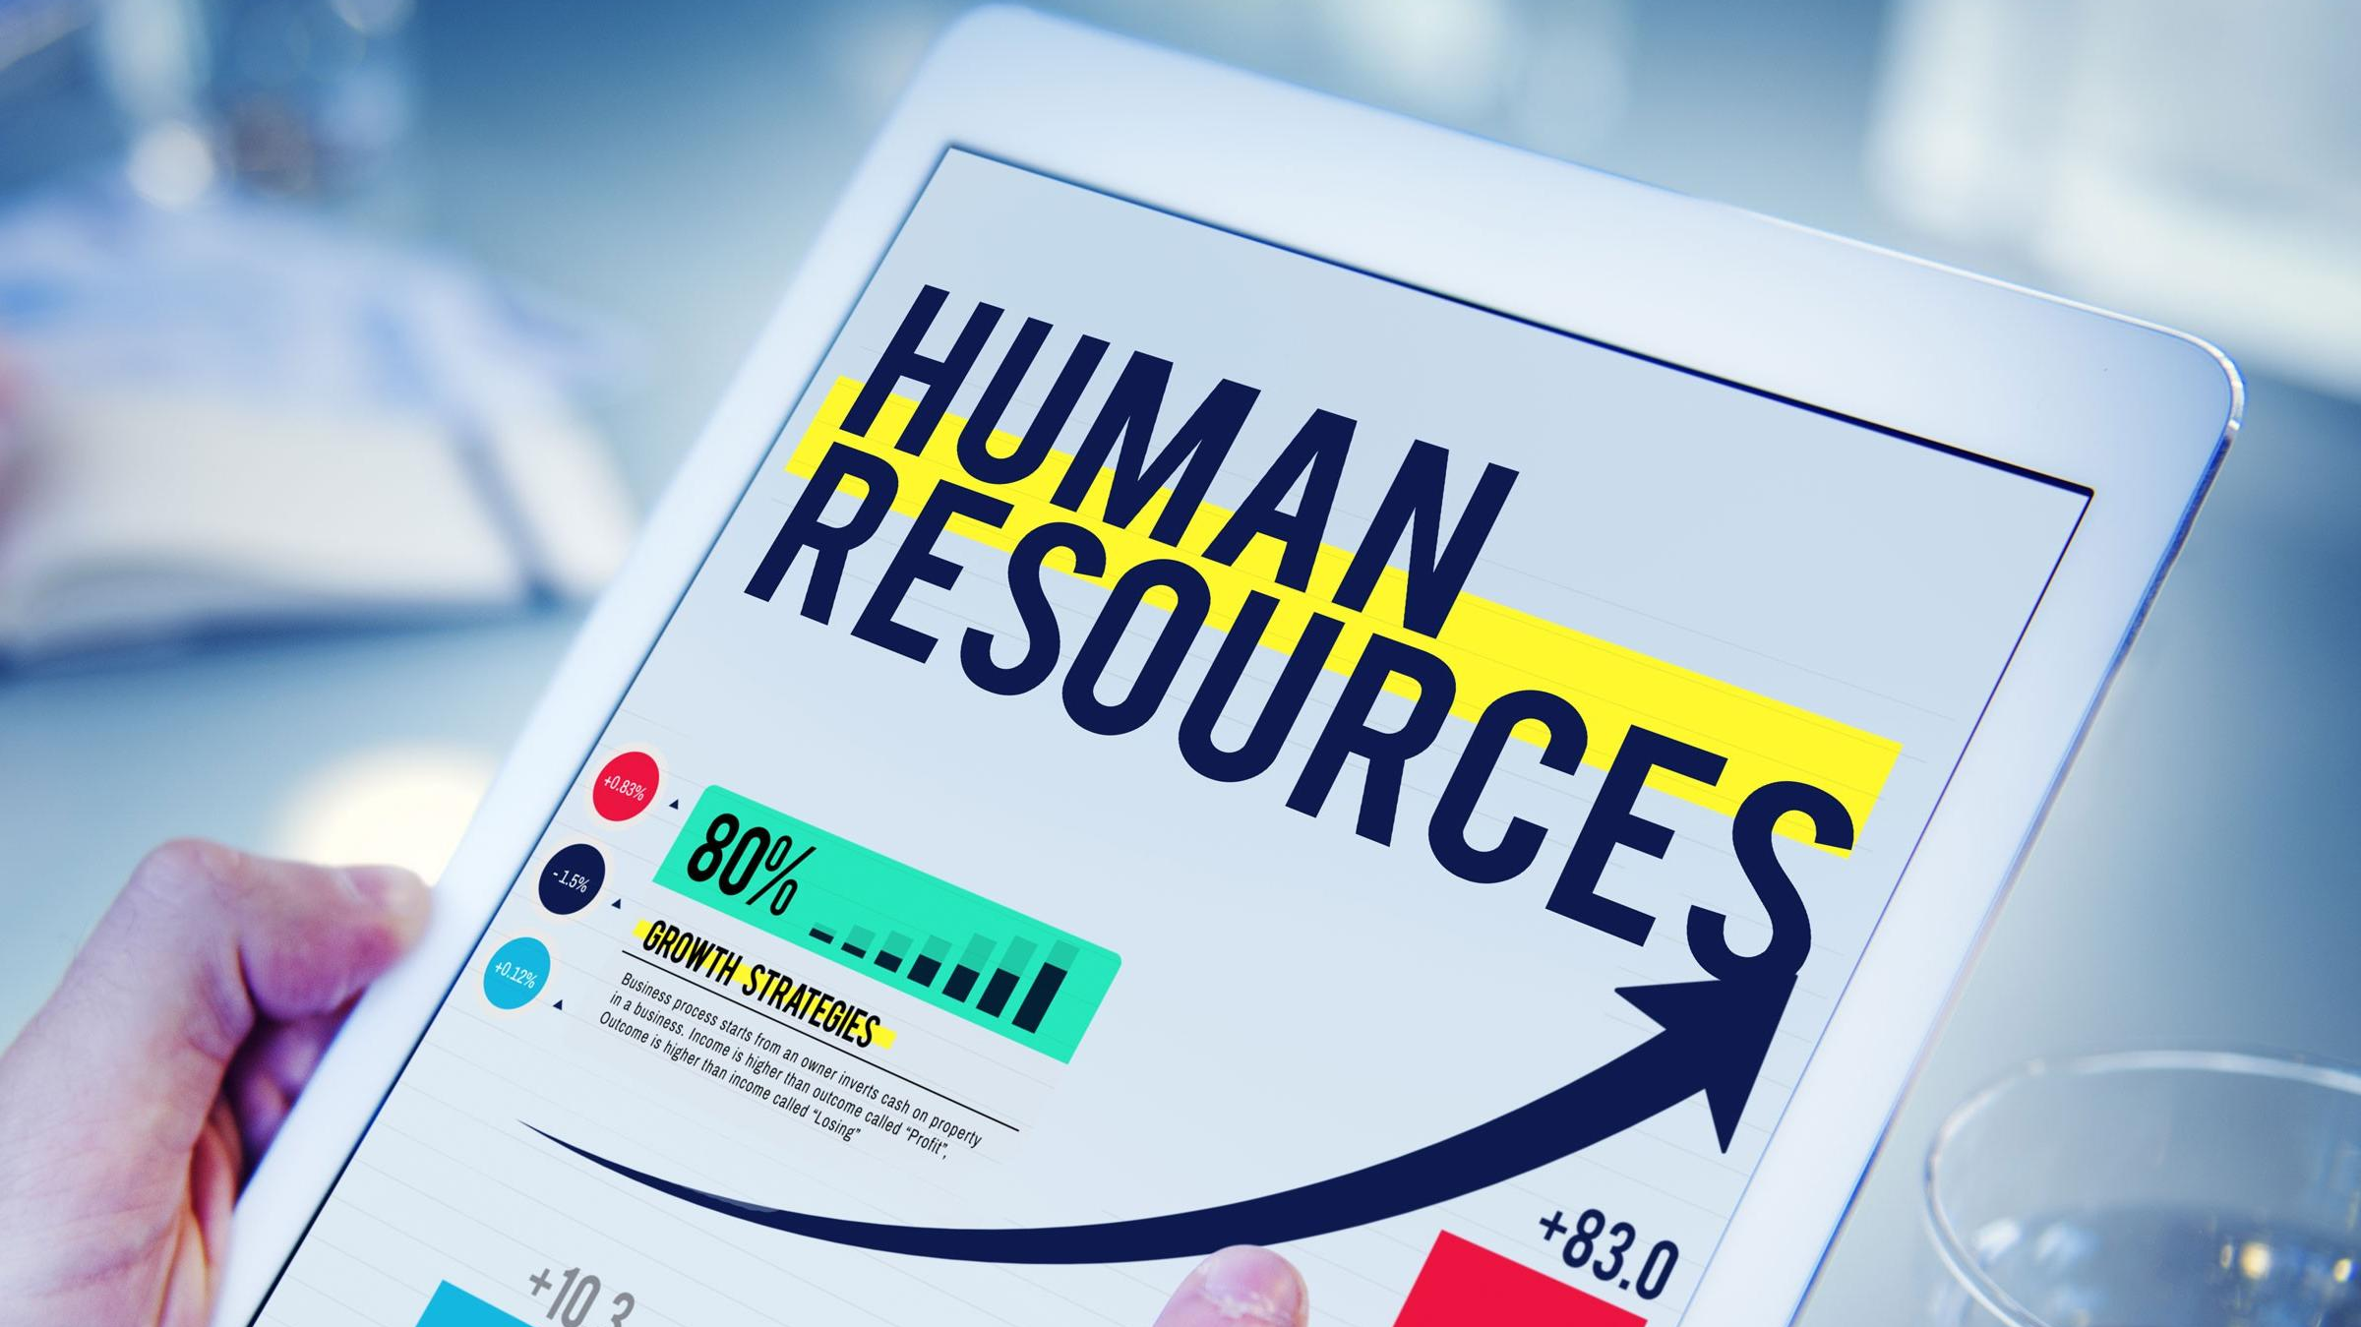
Human Resources
Modern solutions offer a variety of methods for managing corporate data and facilitating employee management tasks such as payroll and recruitment. You can also monitor employee performance and identify HR issues before they occur.

Slide 17
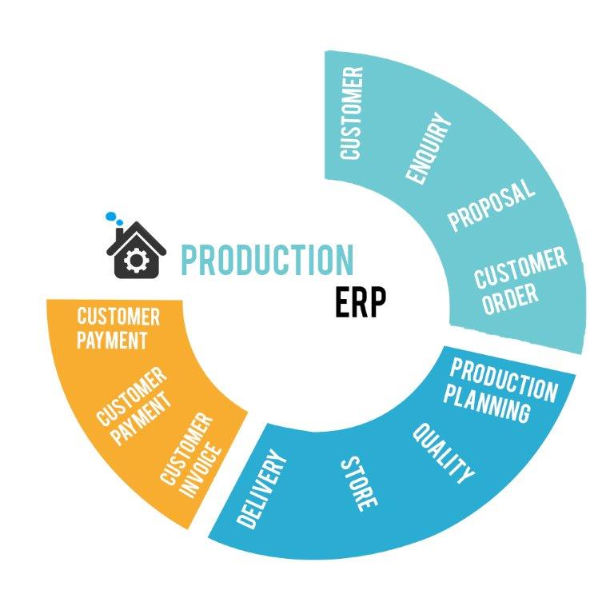
Production
This function improves business communication, automates everyday operations, enables manufacturers to meet customer requirements and manage resources by accessing real-time data. This solution improves project planning and cost management as well as production planning.

Slide 18
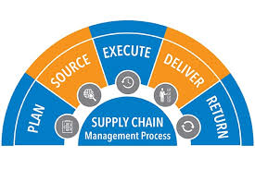
Supply Chain
If your organization still enters information manually and inventory inventory is discovered in your warehouse, you can easily save time and money by automating these processes with ERP.
Modern solutions also provide dashboards and business intelligence to help you manage inventory management.

Slide 19
Improved Collaboration
The features of ERP applications can vary slightly depending on the program you are using, but generally, all systems improve collaboration in some way. As mentioned before, the centralized database is an integral part of what makes an ERP unique. With this database, you provide your company with a single source of truth to work from. This reduces any errors brought on by working with the incorrect data, further reducing costs.
A central database reduces any hesitation or stalling during projects, since all team members have access to the company-wide data they need. Additionally, there’s no need to merge information across various systems or sources. Because all of the data is compiled, stored, shared and accessed through a single system, there is no concern about how accurate, complete or secure the data files are.

Slide 20
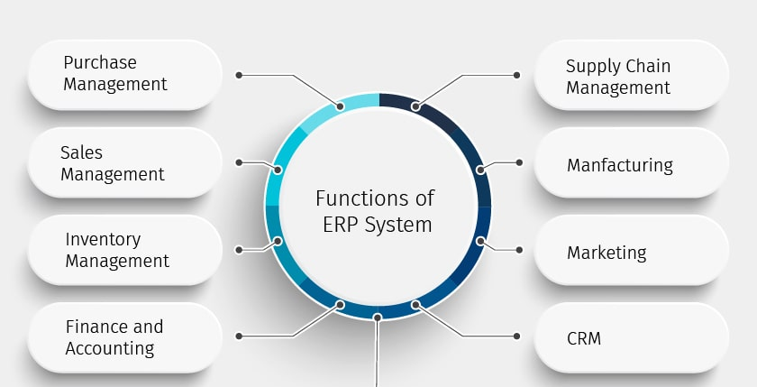

Slide 21

Better Analytics
A central database of information also aids in improving your analytics and reporting. Since an ERP records and stores all the data users input, it makes for an excellent business intelligence tool. As long as your vendor provides strong functionality, ERP software makes it easier and faster for your team to generate various reports. Reports that could take days of research and compilation without an ERP takes just minutes.
Most ERP systems provide a customizable dashboard so executives can see reports when they first log into the system. These reports may include everything from income and expense statements to custom KPIs that offer insight into certain functions. The ability to have access to these reports quickly enables you and your team to make better decisions more quickly. You no longer need to rely on your IT staff to generate the reports that you need. Lastly, reports typically come with access levels, ensuring only relevant staff see valuable company data.

Slide 22

Happier Customers
Managing your customers has never been so important. In our digital age, more and more people are turning to the internet to receive advice on what clothes to wear, what food to eat and how to live their lives. And with 84 percent of consumers trusting online reviews as much as they would a friend, previous customer opinions are more impactful than ever.
The best way to improve customer satisfaction is to provide client-centered goods and services. ERP provides this in a few different ways. First, most ERP systems are equipped with a customer relationship management (CRM) tool or can be easily integrated with one. With an ERP, your CRM has access to data across business functions.
Along with contact information, an integrated CRM can show you details such as order history and billing information. This enables your team to see your clients more holistically to gain a better understanding of their wants and needs. The increased customer visibility helps you formulate your sales strategy for improved lead generation.

Slide 23

THE 8 BEST ERP SOLUTIONS FOR 2019 AND BEYOND

Slide 24
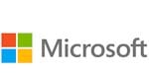
Microsoft provides ERP software to businesses of all sizes through its Dynamics platform which consists of six separate products: Microsoft AX, GP, SL, NAV, CRM, RMS. The Microsoft Dynamics portfolio started in 2001 with the acquisition of Great Plains Software and Soloman, and in 2002 with the acquisition of Navison and Axapta. IThe company’s most adopted ERP offering, Microsoft Dynamics AX, is a business solution for global enterprises that supports industry-specific and operational business processes, along with comprehensive, core enterprise resource planning (ERP) functionality for financial and human resources management.

Slide 25

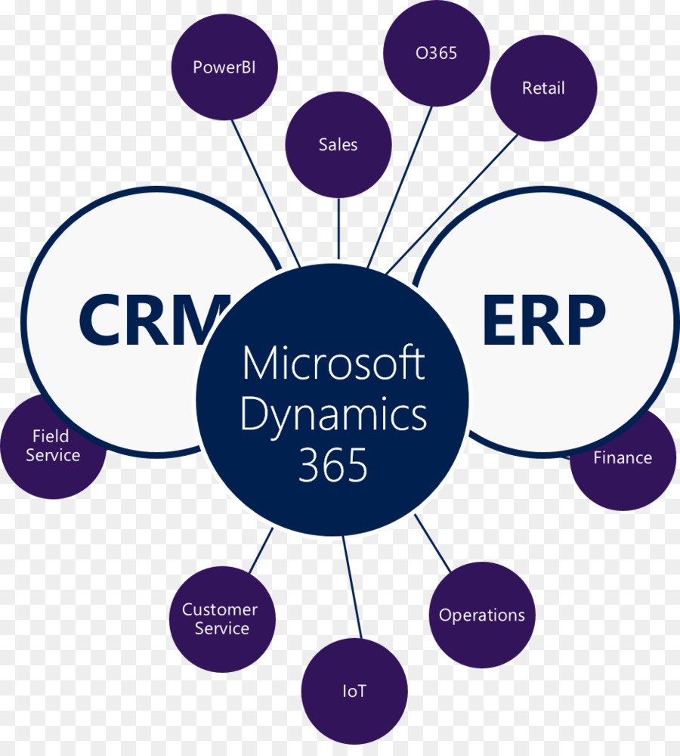

Slide 26

Sage provides ERP software directed to small and medium sized companies; helping them to make smarter business decisions. Sage’s ERP software is available in three different products; X3 for enterprises, 100 for small and mid-sized light manufacturers, and 300 for small and mid-sized businesses with multiple locations. The company’s most adopted ERP tool, Sage ERP X3, comprises a number of features and functions designed to help manage your business’s sophisticated processes, transactions and relationships. It can manage specific areas such as manufacturing, inventory, warehousing, purchasing, finance, customer relationship and even electronic document systems.

Slide 27
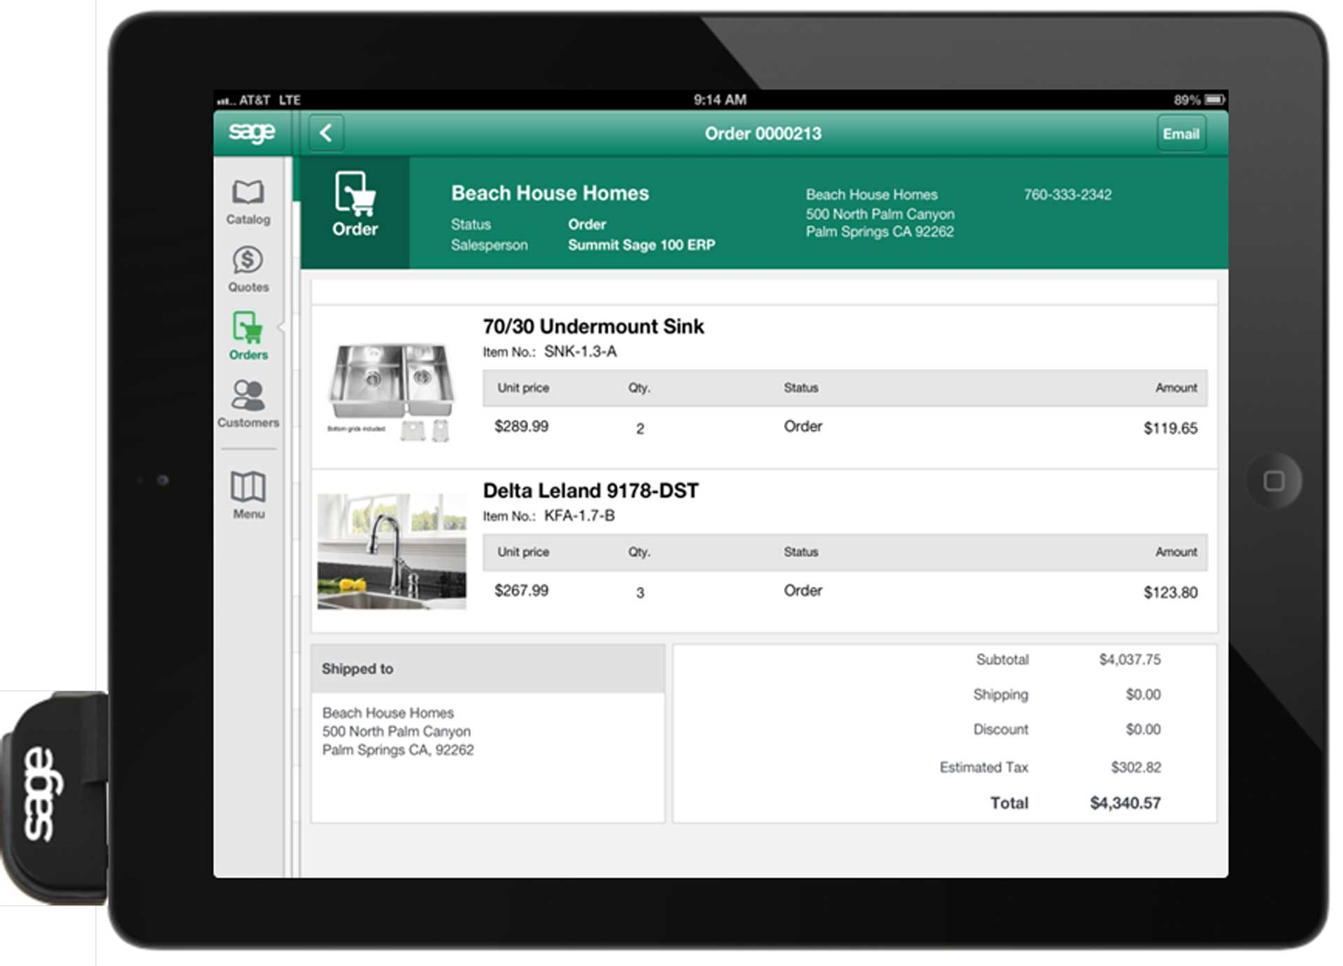

Slide 28

Odoo is an open-source ERP software provider for businesses of all sizes and industries. With the “On-premise” offer, Odoo is the most installed business software in the world; used by over 3.700.000 users worldwide ranging from startup companies (1 user) to large enterprises (300,000+ users). Odoo’s distinction is that the whole system revolves around a collection of apps. The software has apps to cover everything from warehousing, manufacturing, and sales channels, to timesheets, websites, purchasing, and more.

Slide 29
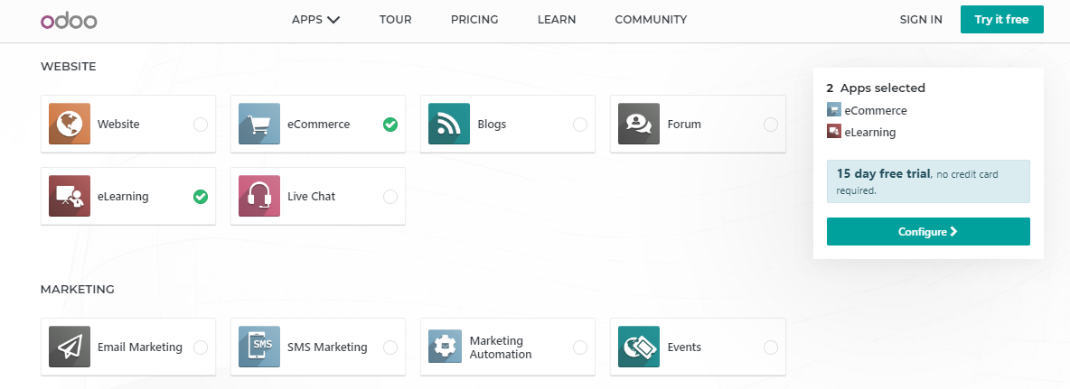

Slide 30
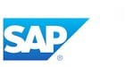
Trusted by nearly 50,000 customers, SAP ERP supports business processes in 25 industries, 37 languages, and 45 locations. The company offers multiple ERP solutions all built for specific industries and sizes. SAP’s Business One Suite ERP software provides strong functionality across a number of industries including manufacturing, services, retail, wholesale distribution, and more. Within Business One Suite’s ERP suite, it offers applications covering customer relationship management, financials, human capital management, and product lifecycle management.

Slide 31
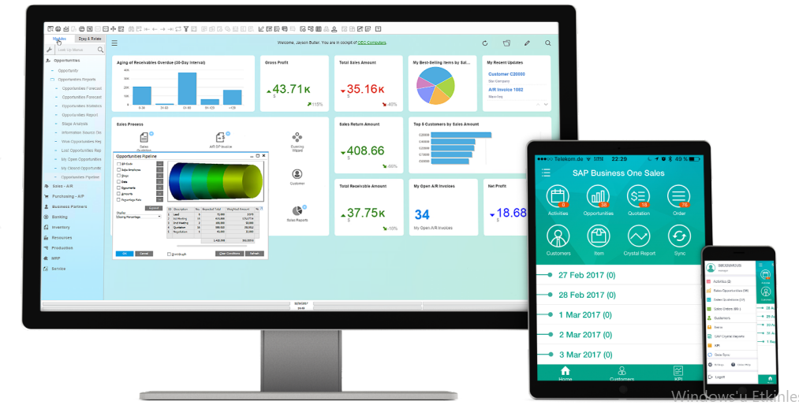

Slide 32
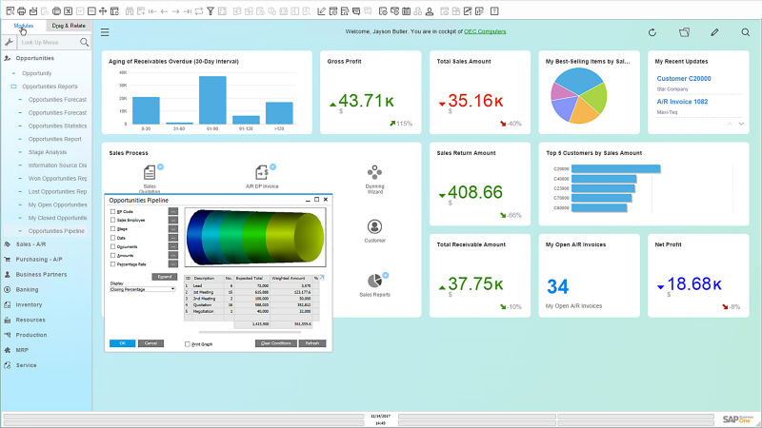

Slide 33
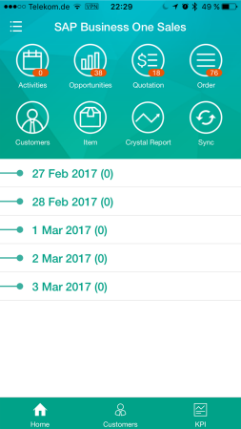
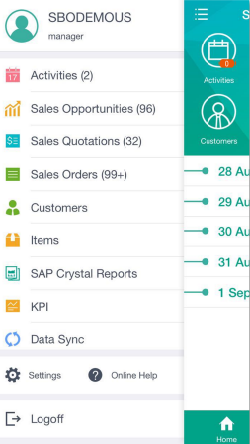

Slide 34

Netsuite’s ERP solution is designed to address the multinational and multi-company needs of a mid-market organization. NetSuite’s ERP offering allows consolidation to be done in real-time and includes automated intercompany eliminations and foreign currency translation. As one of the world’s most deployed cloud ERP solution, Netsuite ERP provides proven financial management and ERP that easily integrates with your broader sales and service processes. NetSuite ERP equips you with the visibility you need to make better faster decisions.

Slide 35
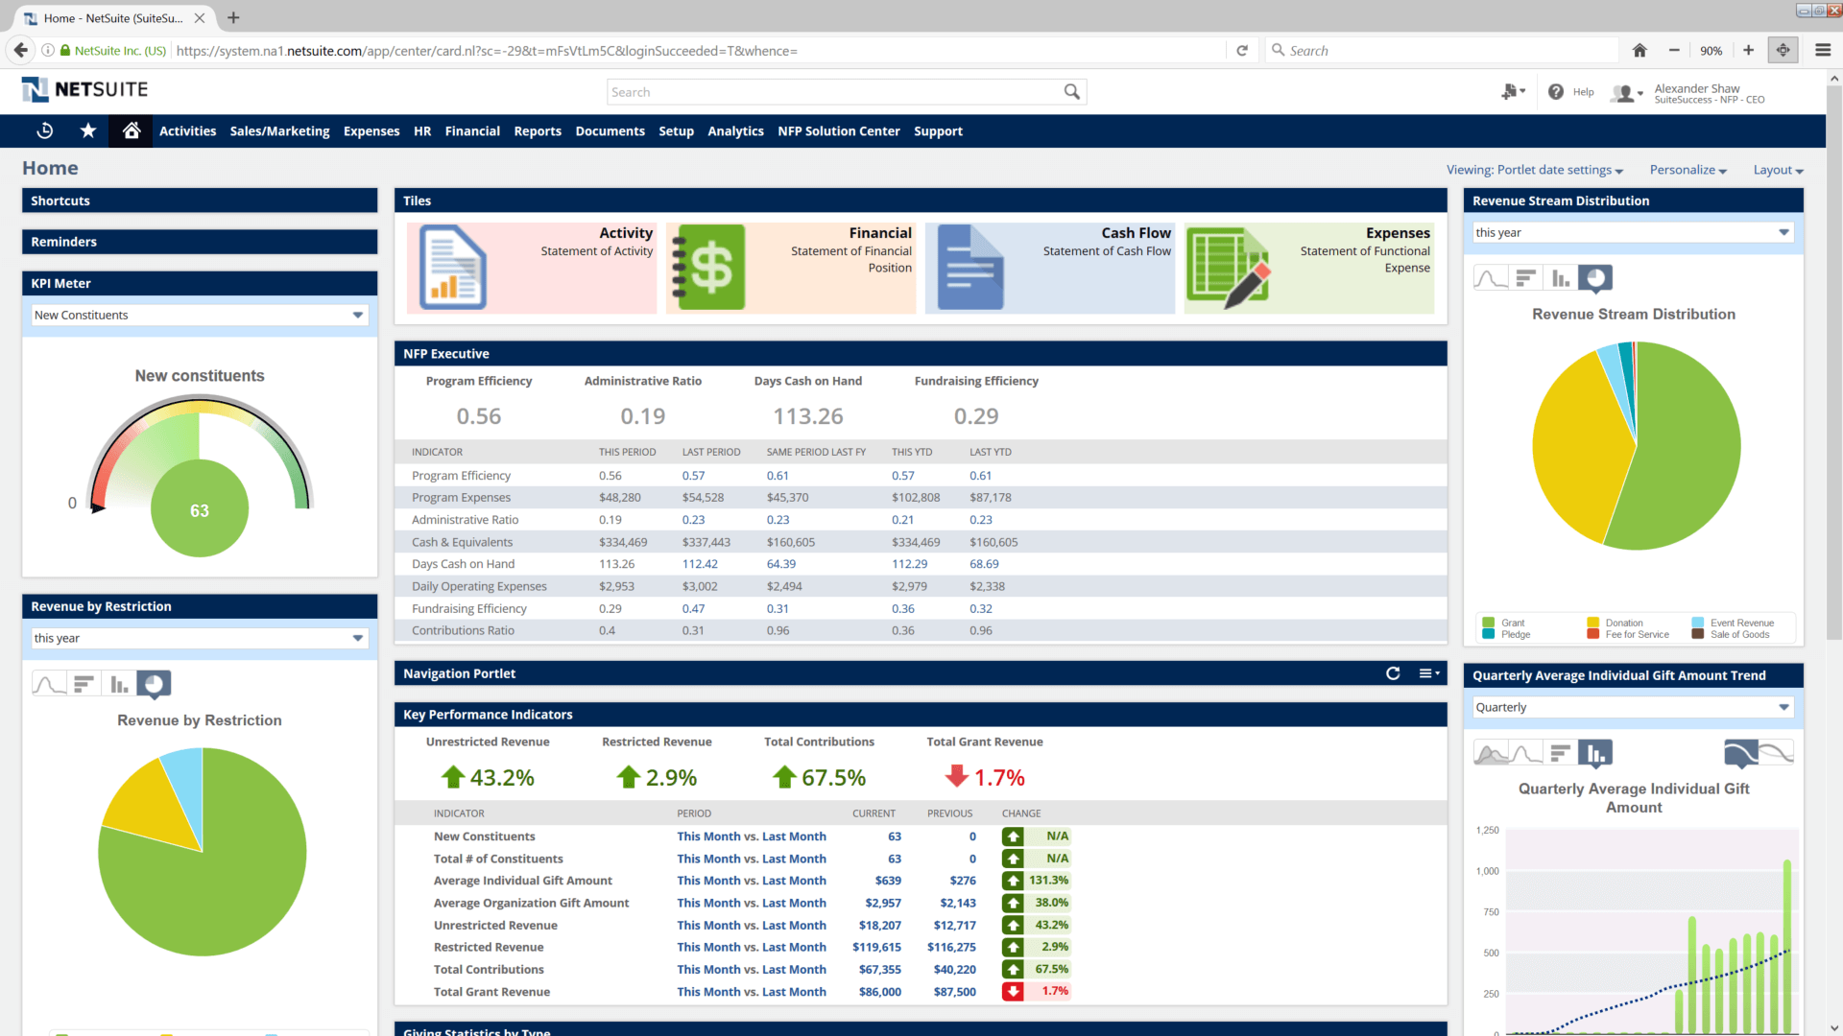

Slide 36

Infor is a privately held software company founded in 2002 and offers both cloud and on-premise ERP solutions used by over 9,700+ manufacturing, distribution, equipment rental and service customers in a wide variety of industries worldwide. As a company that’s been building ERP solutions for enterprise-level and small-medium sized businesses for more than 15 years, Infor’s industry-focused CloudSuite solutions help to minimize cumbersome modifications and take advantage of continuous innovation.

Slide 37

Deltek offers a range of ERP products to fit the unique demands of clients including: Costpoint, Maconomy, Deltek for Professional Services, Ajera, and Vision. Deltek’s ERP solutions are available as cloud-based and on-premise systems, some are priced on a per employee per month basis. Chosen by more than 20,000 organizations as the engine upon which to power their business, Deltek’s Project ERP solutions are built to help efficiently manage resources, better service clients, and grow profitability for firms of any size. With Deltek ERP, you can develop new business with a clear overview of your pipeline, scope new projects accurately and control finances with multi-company and multi-currency project accounting and full general ledger.

Slide 38

Epicor looks to help organizations take advantage of economic changes with its ERP solutions suite. Epicor’s ERP solution is a global resource planning platform that provides choice, flexibility, and agility to promote growth and opportunity. The company provides ERP solutions for manufacturers, distributors, retailers, and service providers. Built for companies of all shapes and sizes, ERP solutions from Epicor gives you better visibility into global business processes and supply chain, build a more data-driven organization, improve productivity and collaboration and raise the bar for quality and compliance.

Slide 39

ERP
FAİLURE

Slide 40
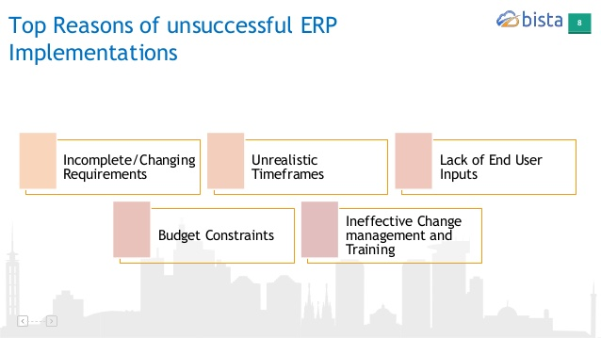

Slide 41

NIKE
Back in 2000 and 2001, Nike spent $400 million dollars updating their supply chain system and ERP. They were surprised to find that what it got them was a ghastly 20% dip in their stock, $100 million dollars in lost revenues, and a myriad of class-action lawsuits. Where did they go wrong? They implemented and launched a new demand-planning solution without appropriate testing and everything went awry. Rather than helping Nike match their supply with demand and shortening their manufacturing cycle, they ended up ordering low-selling sneakers in place of high demand ones, collapsing the supply chain.

Slide 42

HERSHEY
Perhaps one of the best-known ERP implementation failures occurred at Hershey’s during the Halloween season in 1999. Due to mishap after mishap involving the company’s SAP ERP, CRM, and supply chain applications, the company failed to deliver $100 million dollars worth of Hershey Kisses during the season, resulting in a startling 8% stock dip.

Slide 43
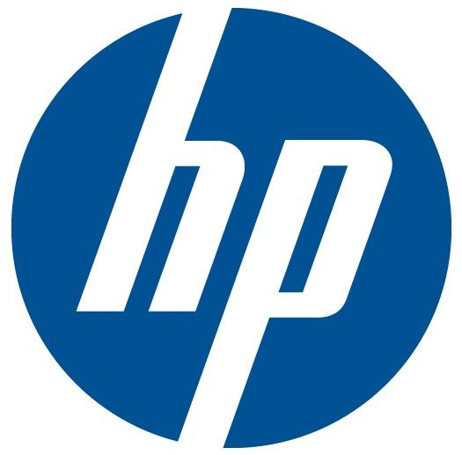
HEWLETT PACKARD
While it is not uncommon for small disasters or issues to occur during the rollout of a new ERP system, total ERP implementation failure can occur when too many of these little issues occur all at once. This is what happened at Hewlett Packard. Moving all of the company’s North American divisions into a single centralized ERP system ended up costing the company $160 million dollars in backlogged orders and lost revenues, more than five times what the project was estimated to cost in 2004.

Slide 44

Perhaps most startling, the United States Navy sunk $1 billion dollars into four different ERP pilot projects since 1998, and all four have failed. All four installations, which were based on SAP AG software. turned out to be incompatible and redundant, ultimately failing to meet the requirements of the Navy. While in this case, the only cost was the money spent on purchasing the programs, this is an ERP implementation failure of epic proportions.

Slide 45
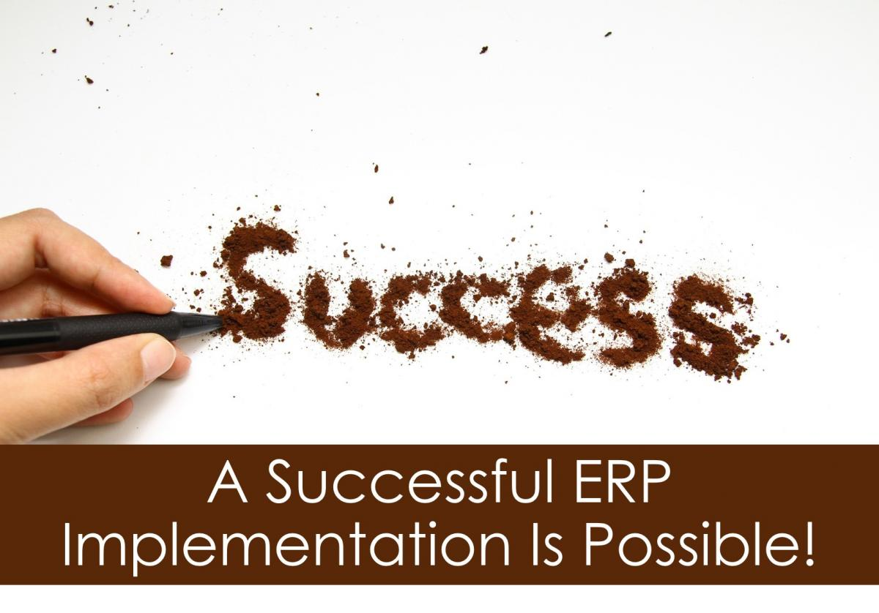
60% of all ERP (Enterprise Resource Planning) software solutions fail to achieve the desired results. Whether it be a failure in ERP implementation or integration with the company’s processes, it is a scary number that represents a worst case scenario for anyone shopping for an ERP system.

Slide 46
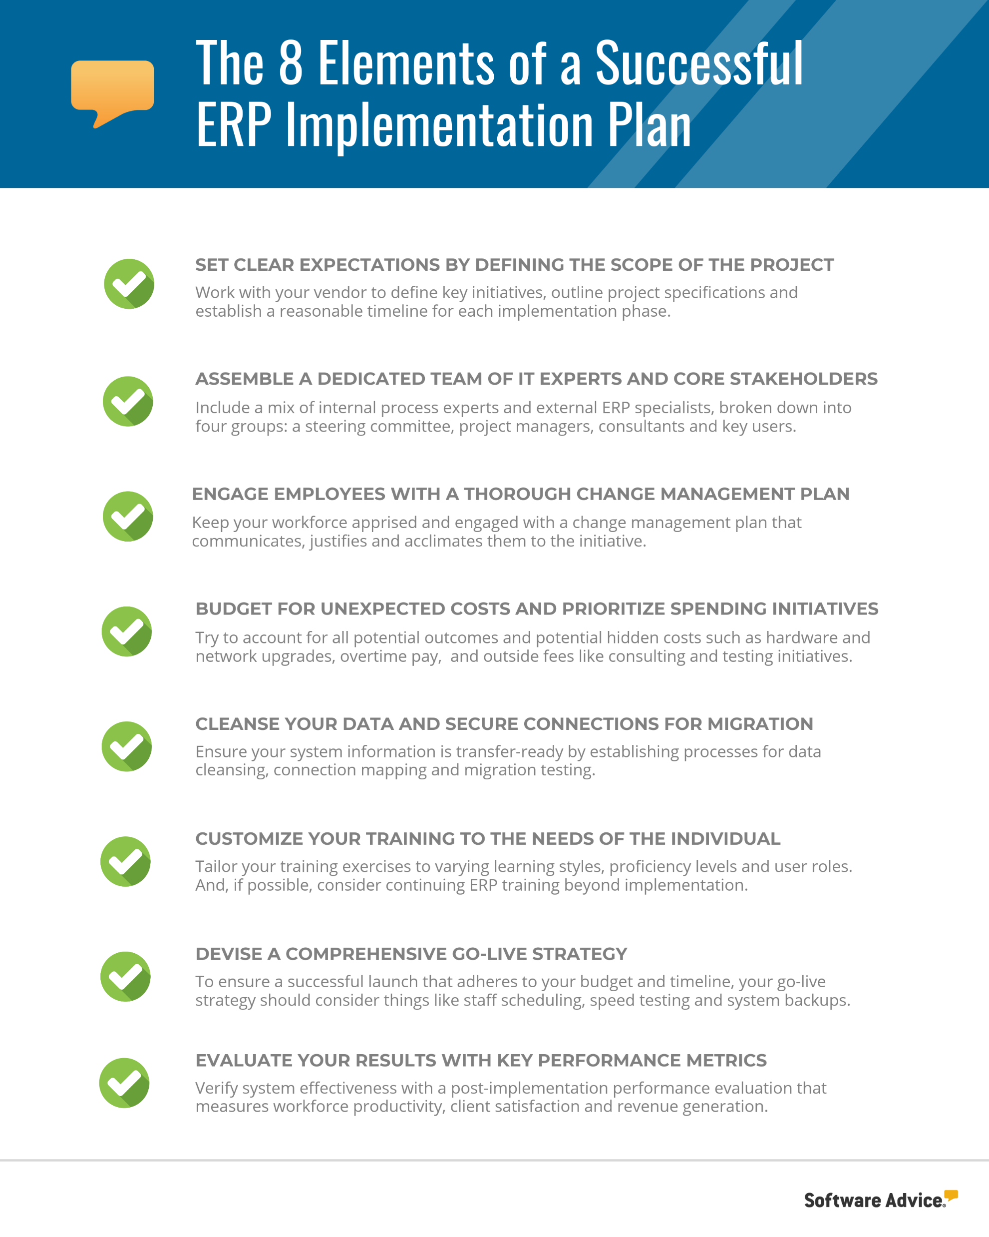

Slide 47
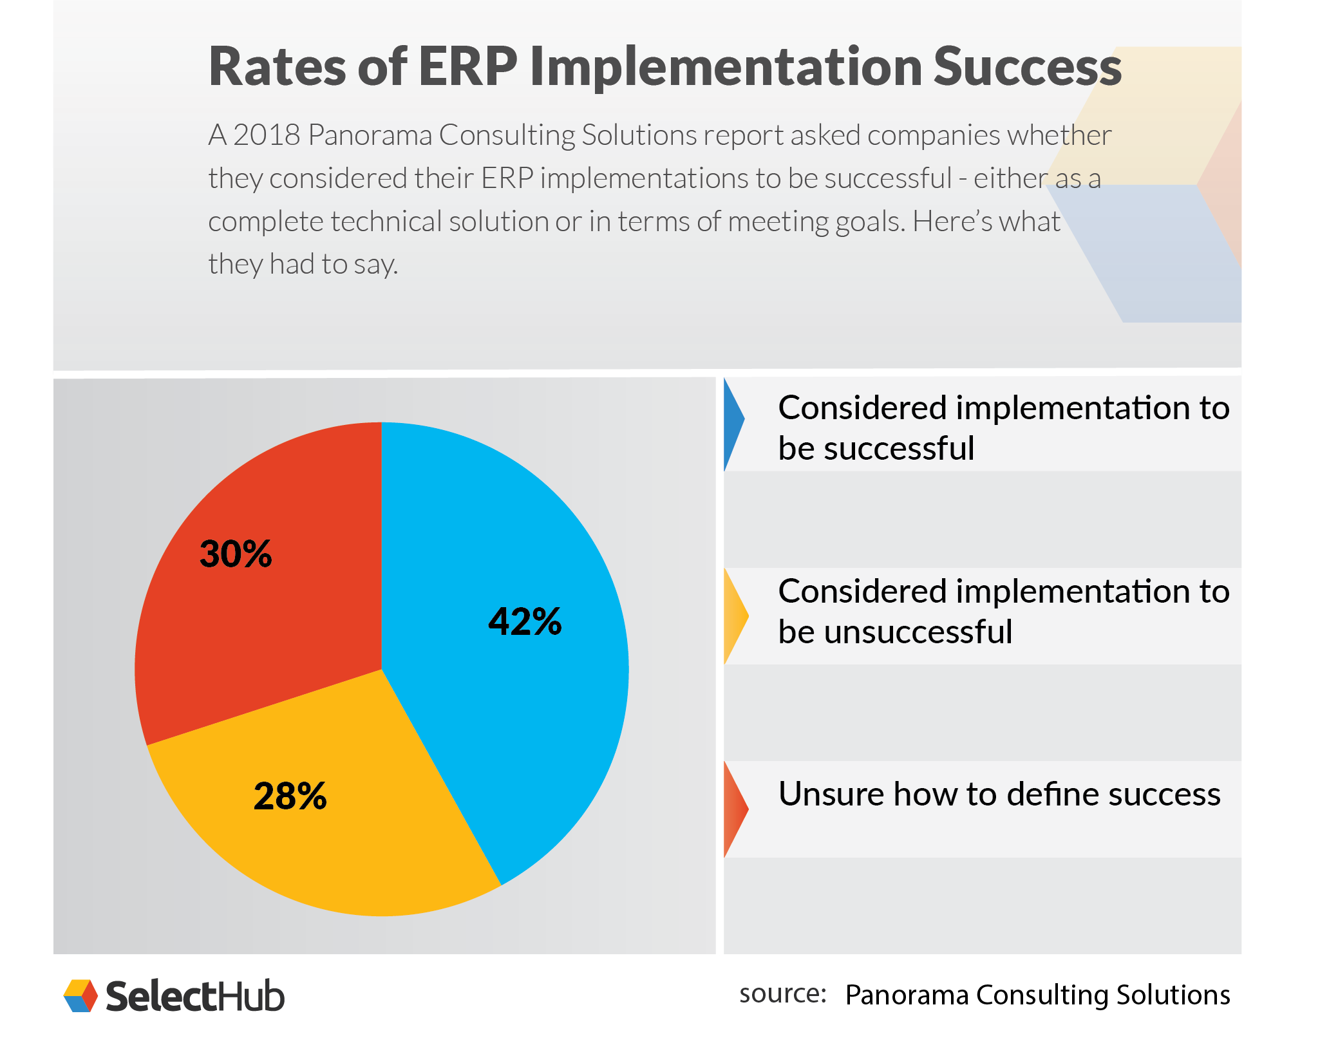

Slide 48
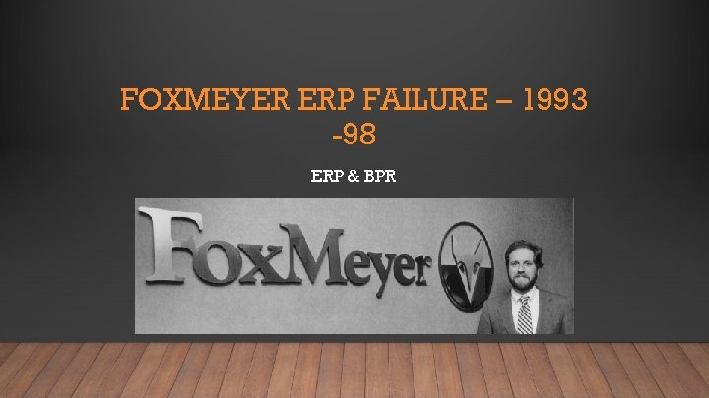
FOXMEYER
FoxMeyer Drugs, a $5 billion-dollar company, implemented a $100 million dollar ERP system and went completely bankrupt not long after. Did the two have a correlation? They launched the Delta III project in 1993, and implementation began between 1994 and 1995. By 1996, FoxMeyer had been driven into bankruptcy, and by 1997 the pharmaceuticals company was suing SAP, the ERP project vendor, as well as Andersen Consulting, responsible for integrating the system for $500 million dollars apiece.

